Slide 1
Other Generative Models

Slide 2

This Week’s Agenda
AI News
Quiz 4 Review
Other Generative Models / Architectures
Generative Adversarial Networks
Variational Auto-encoders & Diffusion Models
Quiz 4

Slide 3
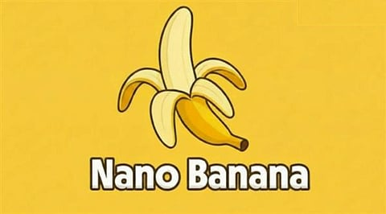



Generative Image, Audio, Video Models
Generative Models Have Taken Off
Text-to-Image: Stable Diffusion, DALL-E, Nano Banana.
Text-to-Video: Sora, Veo3
Photo to Video: Kling
Text-to-Voice/Speech: ElevenLabs
Text-to-Music: MusicGen, MusicLM

Slide 4
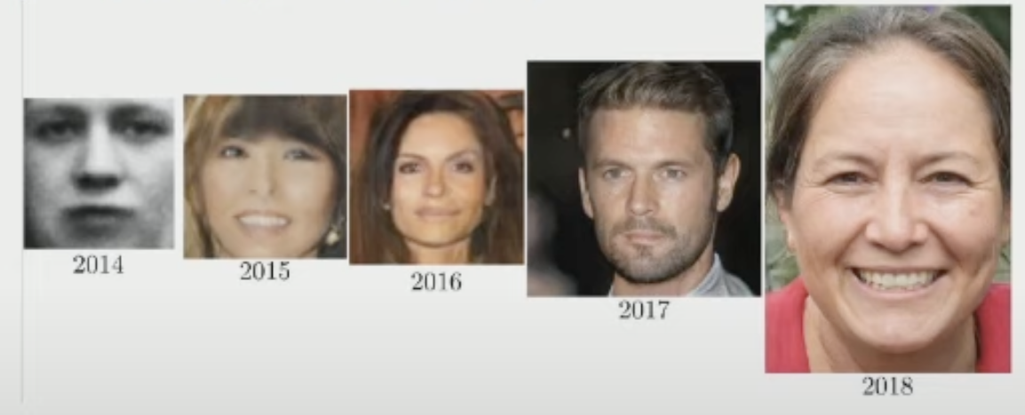
Generative Adversarial Networks (GANs)
GANs are a Powerful Flexible Tool for Generative Modeling
What is a GAN? How do GANs work?
What problems can we address with GANs?
How do we implement a GAN?
Notes:
https://www.youtube.com/watch?v=G06dEcZ-QTg

Slide 5
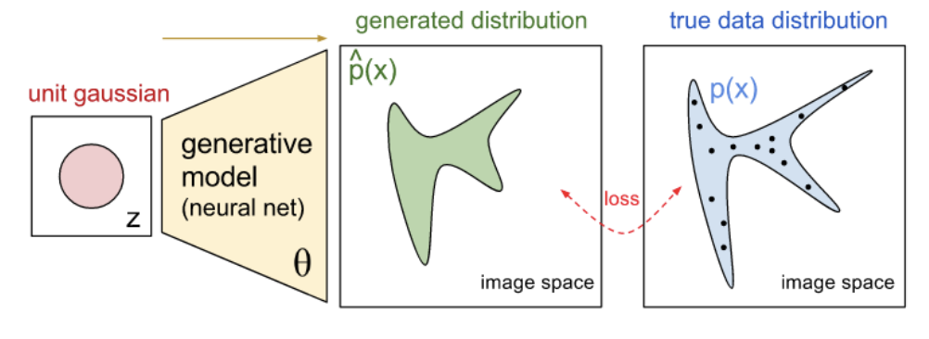
The Goal
Synthesize Samples That Conform to the Real Data’s Distribution
We train a network to produce synthetic samples that are indistinguishable from true samples.
More concrete, this means we train a network to learn the probability distribution of real data.
For example, learn the joint probability distribution of pixel values in a set of images.
So, the resulting network could take a random vector of noise as input, and map it to a synthetic output that looks very similar to real data.

Slide 6
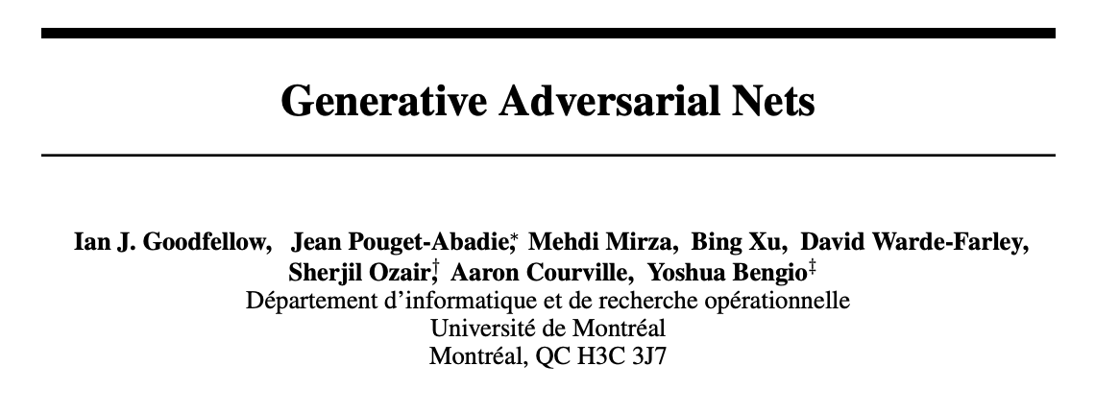
How Might We Do This?
A Neural Net That Produces Image Output
Take in a random vector as input, and have it produce image predictions.
Next, compare those predictions with authentic images. But how?
We don’t want it to try to predict a specific image, because then it won’t be able to produce new synthetic examples.
The problem? The loss function is highly complicated.
A solution…
Notes:
We pair a discriminator with the generator. Discriminator is a standard network we’ve seen before; it’s a classifier. It takes in an image, and predicts whether the image is real or fake.

Slide 7
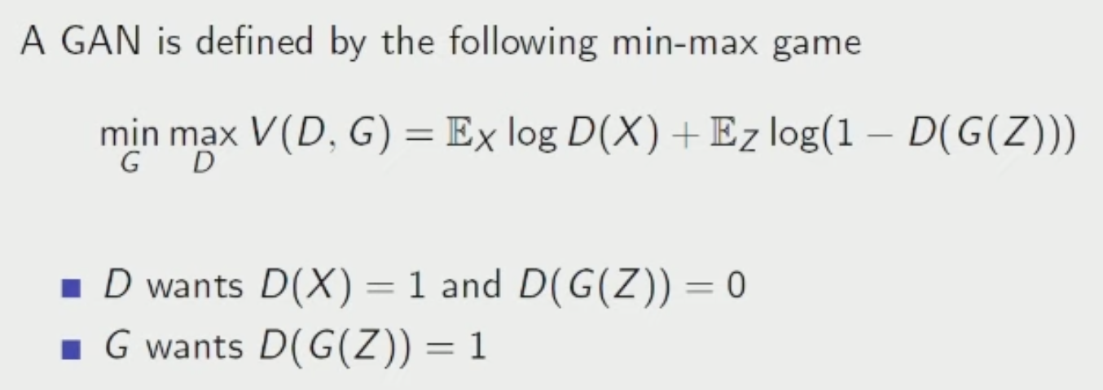
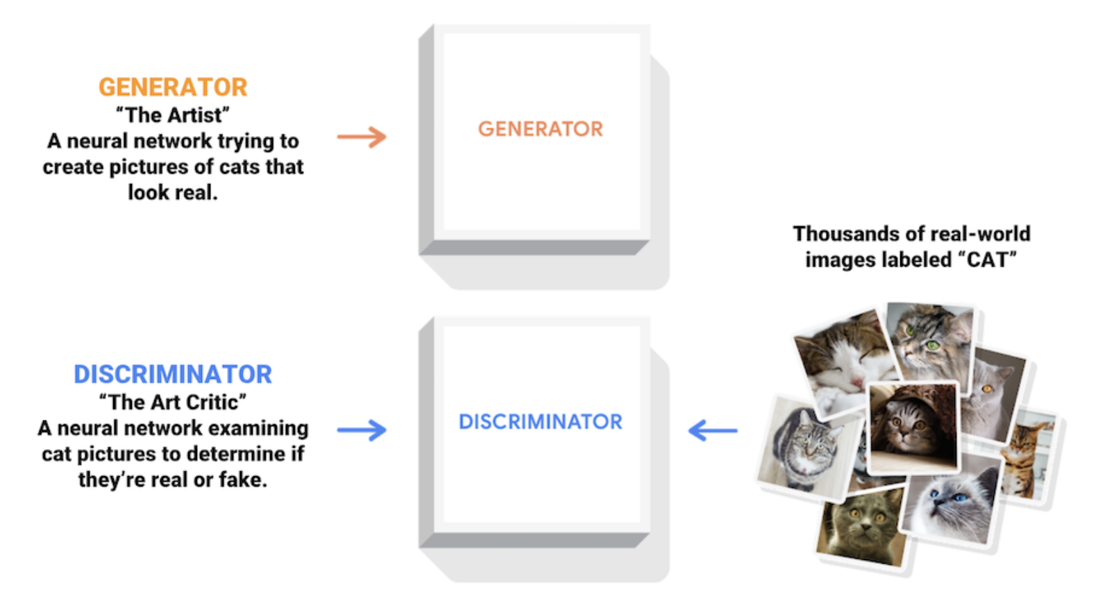
Adversarial Architecture
Discriminator
Serves as an adaptive loss function for the generator.
It’s a throw-away network that is just there to help train the generator.
Notes:
We pair a discriminator with the generator. Discriminator is a standard network we’ve seen before; it’s a classifier. It takes in an image, and predicts whether the image is real or fake.

Slide 8
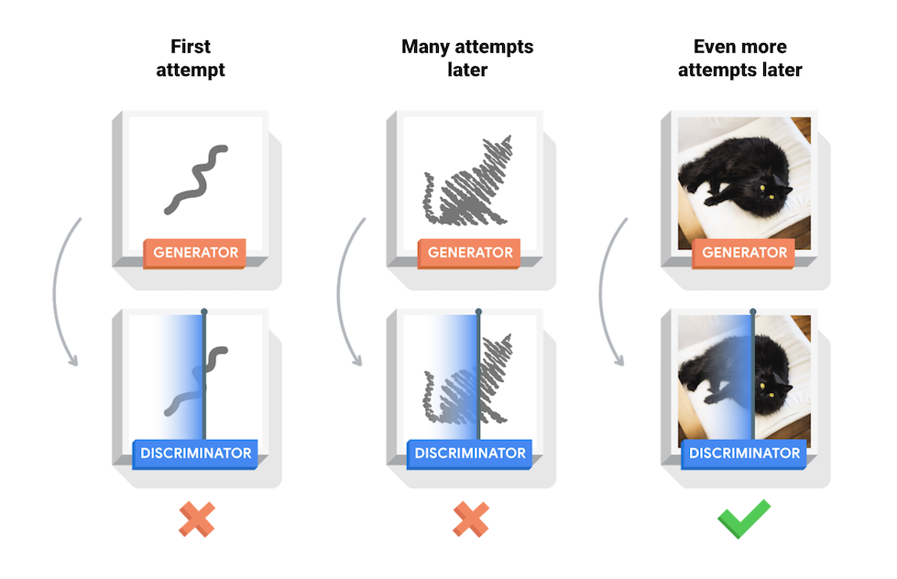
Adversarial Architecture
Notes:
We pair a discriminator with the generator. Discriminator is a standard network we’ve seen before; it’s a classifier. It takes in an image, and predicts whether the image is real or fake.

Slide 9
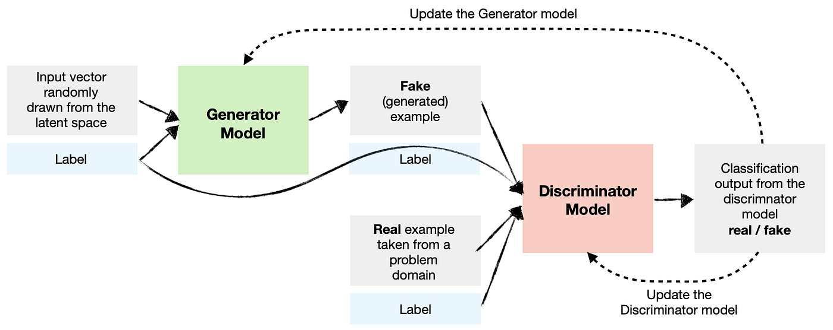
Conditional GANs
GAN /w Labels as Input Too
We don’t want our GAN to just learn P(X); it needs to learn P(X|Y).
This is a simple modification; we give two inputs to the generator, a label and a noise vector. So, it tries to produces images that match real images given a particular label, rather than images in general.
End result is a generator that you can pass a noise vector and a label, and it spits out an image of that label.
Notes:
We pair a discriminator with the generator. Discriminator is a standard network we’ve seen before; it’s a classifier. It takes in an image, and predicts whether the image is real or fake.

Slide 10
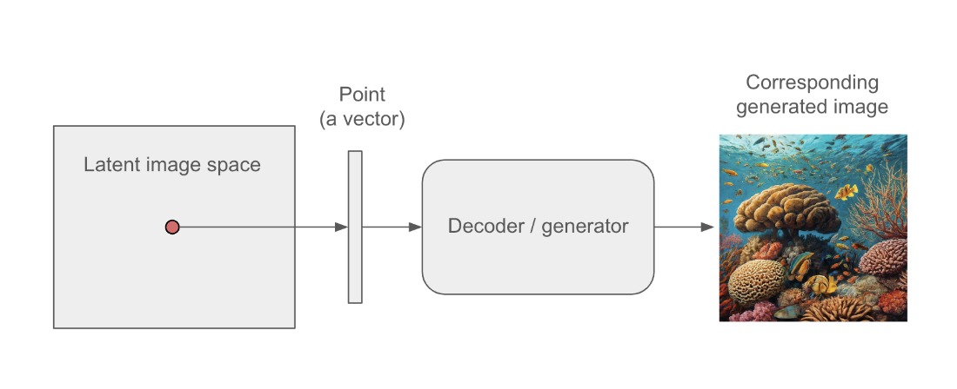
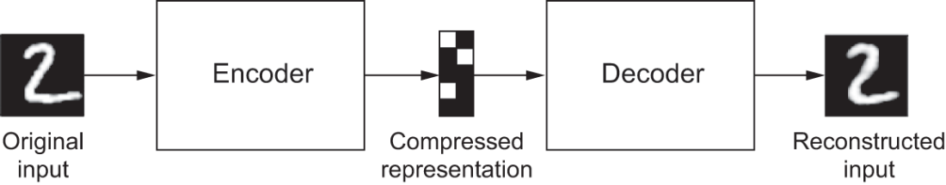
Variational Auto-Encoders
VAEs: employ an auto-encoder architecture (like our translation case, or the image-sharpening example) to compress and recover the input image. The trick is in the architecture we use to capture the compression in the middle (the bottleneck).

Slide 11
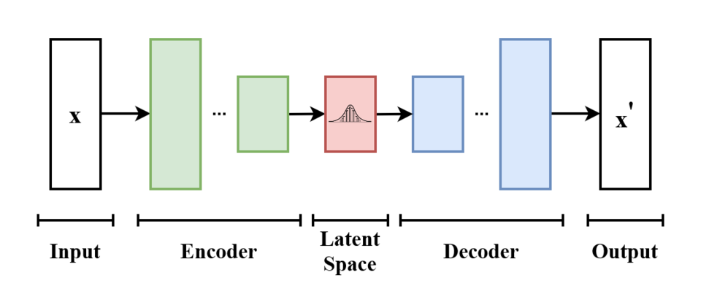
Variational Auto-encoder (VAE)
Mapping Images to a Latent Normal Distribution
We learn to map each image in our training data to a multivariate normal distribution over latent variables — in our example, a bivariate normal with 2 learned means and 2 log-variances.
We do this in a self-supervised way, using the auto-encoder architecture. The encoder compresses each image into parameters of a bivariate normal (2 means + 2 log-variances). We sample from that distribution and the decoder converts the sample back to an image.
How do we enforce the normal distribution? A KL divergence term in the loss function penalizes the encoder whenever its learned means and log-variances drift from N(0,1). This regularization keeps the latent space well-shaped and smoothly interpolatable.

Slide 12
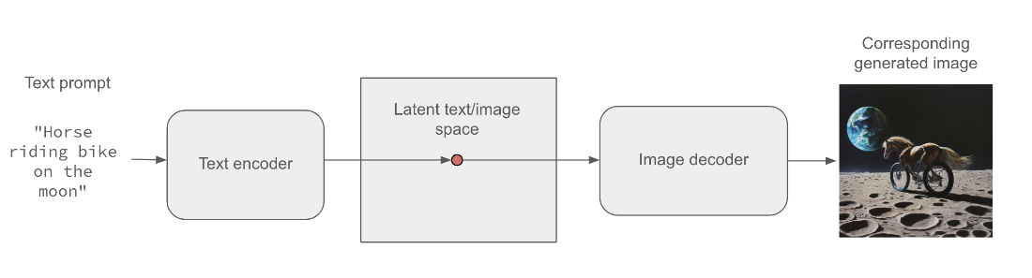
Conditional VAE (Guiding with Text)
We train the model by passing it an image along with textual captions. The image is projected into the latent space as a set of means and variances in a way that considers the text (conditional on the text). The decoder then samples from the normal distributions specified at that point in the latent space and attempts to reconstruct the input image, again taking the caption as input.
At inference, we drop the encoder and randomly sample from the latent distributional space (synthesize a random vector of values). We use that, along with a textual prompt, to synthesize a new image.
Notes:
This is how a Conditional VAE works.

Slide 13
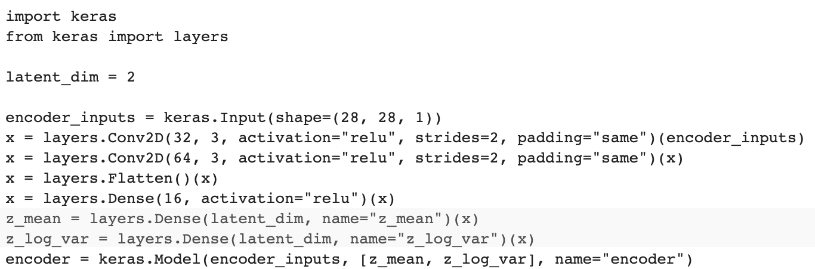
Encoder
The encoder takes in the image and compresses it with convolutions (like our image sharpening task). Two output layers produce the parameters of a bivariate normal distribution: one Dense(2) layer outputs 2 means, another Dense(2) outputs 2 log-variances.

Slide 14
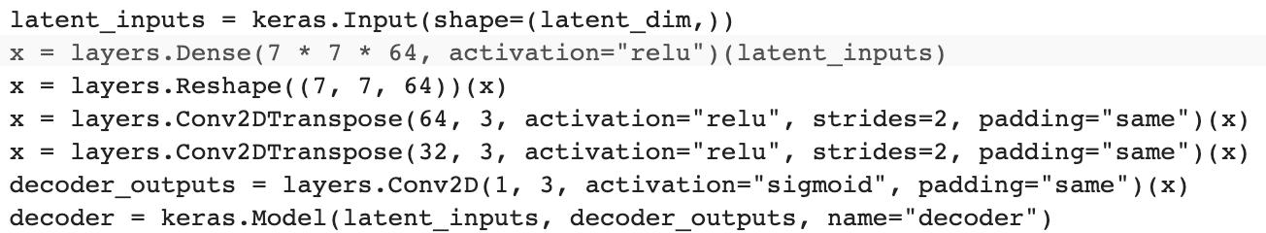
Decoder
We sample a 2-element vector from the bivariate normal defined by the encoder's means and log-variances (the reparameterization trick). The decoder takes this sampled vector and up-samples it back into an image.

Slide 15
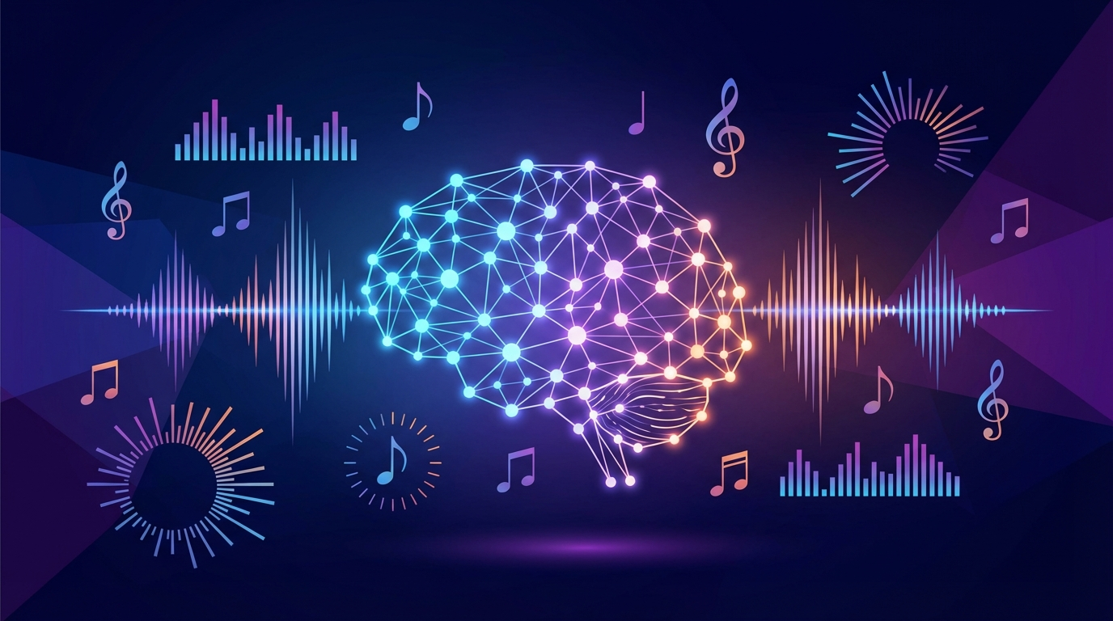
Generative Music Models
Applying Transformers to Music Generation
How can we generate music with neural networks? How do we tokenize audio for sequence modeling? What architectural modifications help with music?

Slide 16
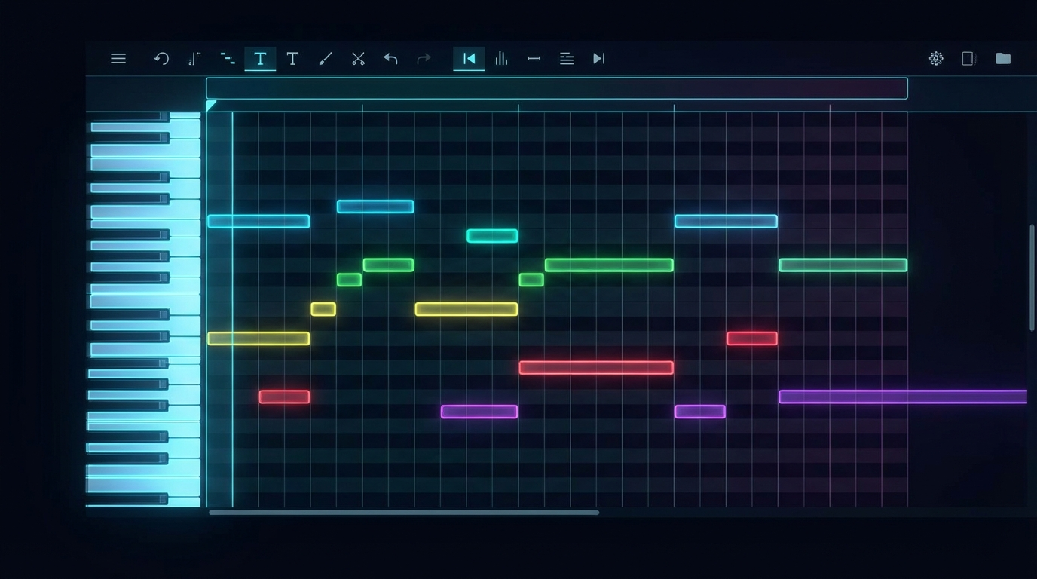
What is MIDI?
Musical Instrument Digital Interface (MIDI)
MIDI stores musical events, not audio waveforms -- digital sheet music. Events are things like Note On/Off, Time Shift (wait), Velocity (loudness). Each event maps to an integer token -- just like words in text models. A piano piece = ~10,000+ tokens a Transformer can learn to predict. Same next-token prediction as Shakespeare & Mini GPT, new modality.

Slide 17
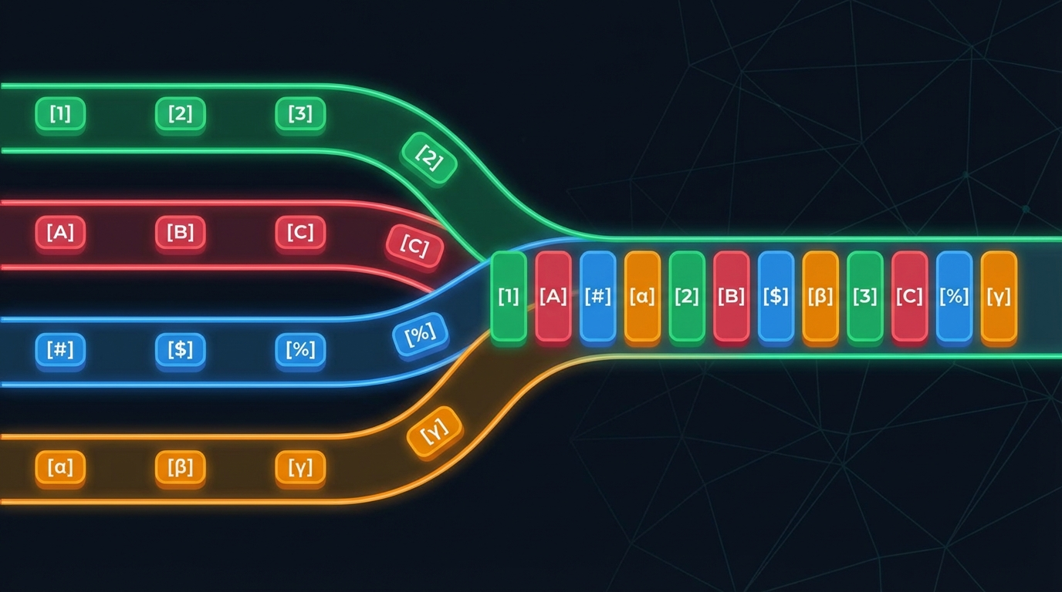
MIDI Tokenization
Four Event Types Map to Integer Ranges
Note On (0-127): Start a pitch. Token 60 = Middle C.
Note Off (128-255): Stop a pitch. Token 188 = release Middle C.
Time Shift (256-355): Wait in 10ms steps (up to 1s).
Velocity (356-387): Loudness (32 levels).
Total vocab: 391 tokens (388 MIDI + 3 special). Compare: ~30K for GPT!

Slide 18

The Music Transformer
Decoder-Only Transformer + Relative Attention
Same architecture as Mini GPT: stacked blocks with causal masking.
Key change: relative positional attention replaces fixed embeddings.
Standard embeddings encode where a token is (position 0, 1, 2...).
Relative attention encodes how far apart two tokens are. Intuition: a melody at beat 1 should sound the same at beat 5.

Slide 19
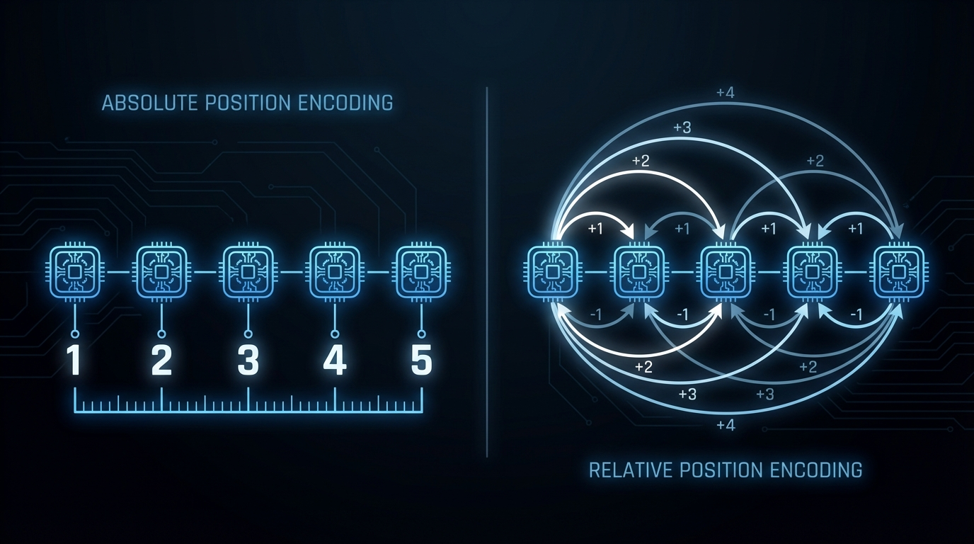
Relative Positional Attention
Encoding Distance Instead of Position
Standard: score(i,j) = f(q_i, k_j) + pos(i) + pos(j); Relative: score(i,j) = f(q_i, k_j) + rel_embed(i - j). Learn embeddings for each possible distance in the sequence. Biases attention toward musically meaningful distances and makes the model translation-invariant in time.

Slide 20
Questions?
Notes:
Weights are not initialized until you “build” the model (or compile it, which will first build).

